Slide 1
JAWS Attack
Team Matt Cooper
Alejandro Figueroa
Alex Lopez
Daniela Rivera
Danielle Steede

Slide 2
Project Overview
The original dataset consisted of 23 columns and almost 7000 rows, many of which contained null values and information that was difficult to understand and clean.
We noticed the type of species varied greatly, leading us to think that maybe the Great White Sharks, although they have a bad reputation, may not necessarily be the predominant species of a shark attack
As a result, we came up with the following hypothesis:
Notes:
DANIELLE

Slide 3
Hypothesis
Hypothesis #1
Hypothesis # 2
The majority of documented shark attacks are not perpetrated by Great White sharks
The majority of shark attacks are not fatal.
These hypotheses challenging the prevailing perception of Great Whites as the primary perpetrators of shark attacks and suggests the presence of other species as significant contributors to human-shark encounters.

Slide 4
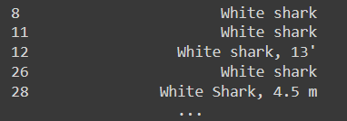
Data Wrangling and Cleaning
After identifying our hypothesis, we inferred that the most relevant columns to prove it would be the following two, each one with its challenges:
Species
Species column had over 3100 null values (represents a 45% loss of data)
Many values were repeated in different formats
To solve this challenge, we use regex to filter our data
for observations which stated a white shark as the
perpetrator.
Injury
Observations describe outcome of attack: fatal or non-fatal
These observations were presented in many formats
For easement of analysis we used regex to check for the following:
If the word “fatal” is in the observation, we assign the value “Fatal”
Else, we assign the value “Non-Fatal”
Notes:
ALEJANDRO

Slide 5
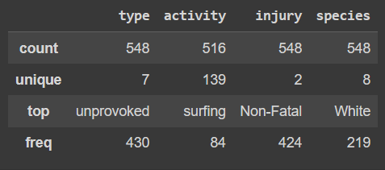
Exploratory Data Analysis
Missing Values
Species → NaN == ‘N/A’
Injury → not as many missing values, we can assume they were non-fatal (mode)
Data Summarization
We can conclude that the most common attacks reported are by a white shark while the person was surfing; the sharks are unprovoked and the injuries are mostly non-fatal
Notes:
ALEX

Slide 6
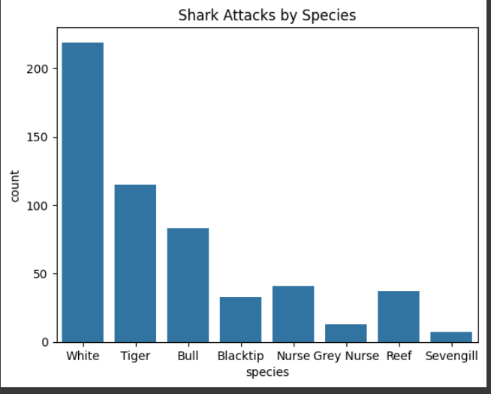
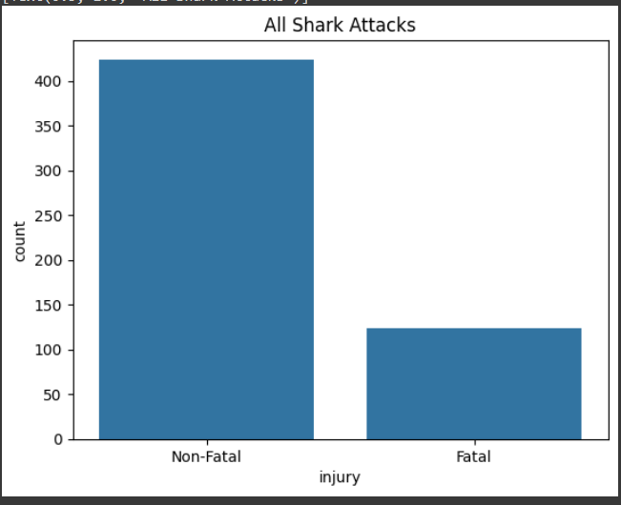
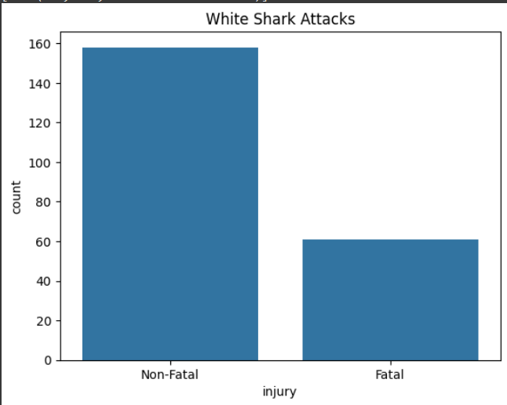
Data Visualization
We were able to create count plots for both the injury and species columns.
We can clearly see the species with the most attacks would be white shark (although many entries have unknown(NaN) species.
Injuries from white sharks are mostly non-fatal
Notes:
ALEX

Slide 7
Major Obstacles
Cleaning the data without losing valuable data; the columns we focused on had thousands of different values
Using regex to identify patterns in order to filter out the values; this may have led to inaccurate data (ex. some species had two options within a value)
For some of us, our lack of knowledge on the topics continues to set us back in terms of contributing with codes and creating functions
Although we didn’t need the numerical data found in the dataset to prove our hypothesis, had we had more time or a better understanding on data cleaning, we could have given a more complete data summarization
Notes:
DANIELA

Slide 8
Conclusion and Insights
Upon analyzing our data, we found that our hypothesis regarding the predominant species in shark attacks was contradicted. However, we believe that the lack of data in said category (approximately 45%) made our findings inconclusive. Additionally, when we consider the combined total of other shark species, it could be argued that they exceed those of the Great White Shark.
As for the possible injuries a person could get when encountered with a shark, it is evident that the majority of reported shark attacks were not deemed fatal, although not exactly a happy tale to tell…
Additional findings for injuries:
For non-fatal injuries the most common included: minor injuries such as lacerations, or shark bites and more severe injuries such as the loss of arm(s) or leg(s)
For fatal values it is also important to note that some of the bodies found may have been a result of drowning
An interesting observation when calculating the fatal ratios by species is that tiger sharks have a higher fatal ratio than white sharks
Notes:
DANIELA & DANIELLE

Slide 9
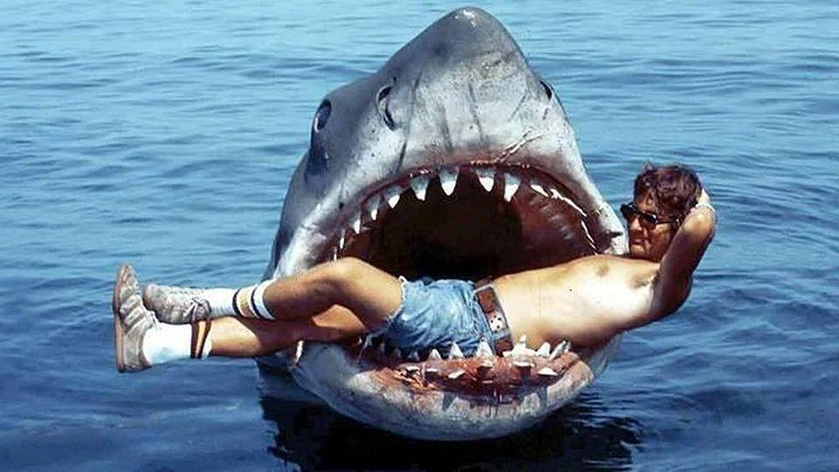
Thank you for your attention!
Team Matt Cooper (P.S Don’t get bitten)

